Slide 1
Text Analytics
Cynthia Rudin | Computer Science and Electrical and Computer Engineering, Duke

Slide 2
Where to text data arise?
Almost everywhere on the internet: webpages, social media pages, tweets, messaging, email, product reviews
News articles, magazine articles
Books, reference manuals
Product descriptions, maintenance logs, customer service logs
Notes:
*Read* this word is full of text data.

Slide 3
What might you want to do with text data?
Summarize it, or represent it in a useful way
Classify it
Search for things within it: information retrieval
Notes:
Here are some of the important things you could do with text
*2 – these comments about our product are positive and these are negative

Slide 4
Frequency of words and stop words

Slide 5
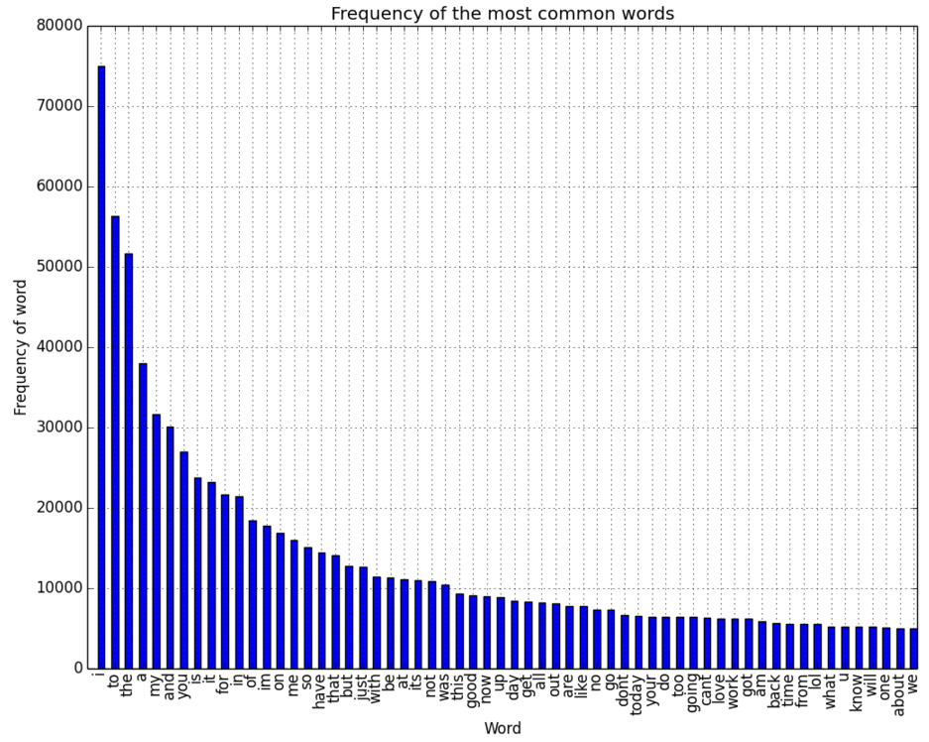
Frequency of words for tweets
Notes:
Consider the frequency of words on twitter. This is a pareto chart, which is a bar chart where the bins have been sorted. Let’s zoom in here and turn this plot sideways so you can see what the most popular words are. So “I” – makes sense that’s a popular word. To, the, a, my, and, makes sense. No matter what you’re talking about, whether you’re being positive or negative, you are going to use those words.

Slide 6
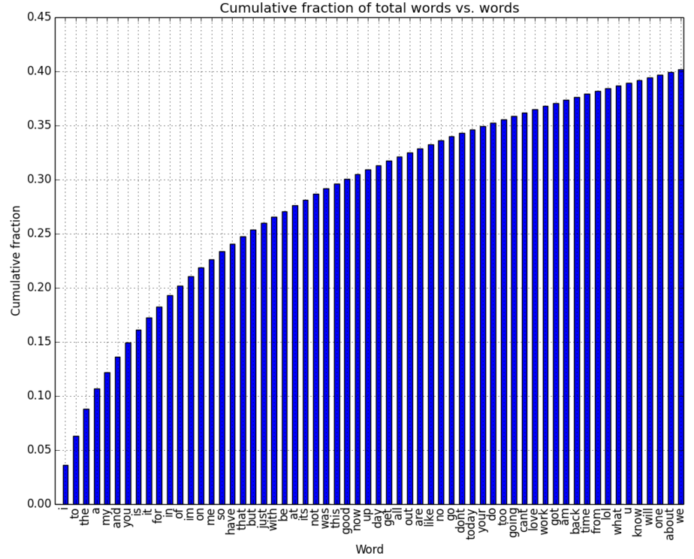
Cumulative fraction of total words vs. words for tweets
Notes:
This is a cumulative view of the same thing. So the word I accounts for something like 4% of the words, and then if you include to and “the”, that’s something like 9% of the total words right there. And if you include a bunch more of the most common words, you’ll very quickly see that almost 40% of the total words in the tweets are these same words over here that have very little content in them. So what happens when we remove the stop words. The stop words are words like the, is, at, which, that, and on, they are very common words that are not very useful for many natural language processing applications.

Slide 7
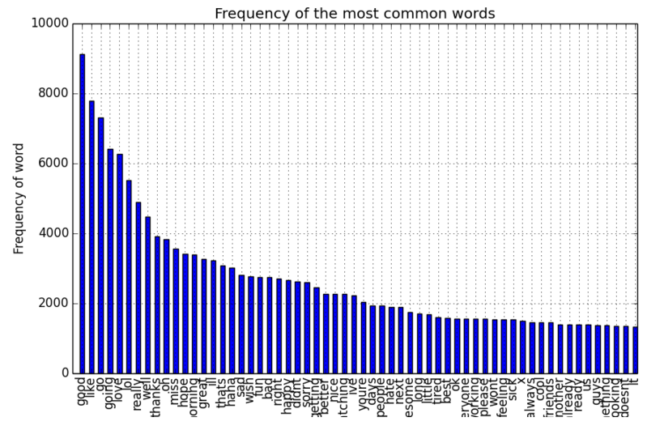
Frequency of most common words for tweets: stop words removed
Notes:
So what’s left looks like this. Good, going, love, hope, thanks. I have to say, it makes me thing positively about humanity when I see such positive words being the most common words! Anyway.

Slide 8
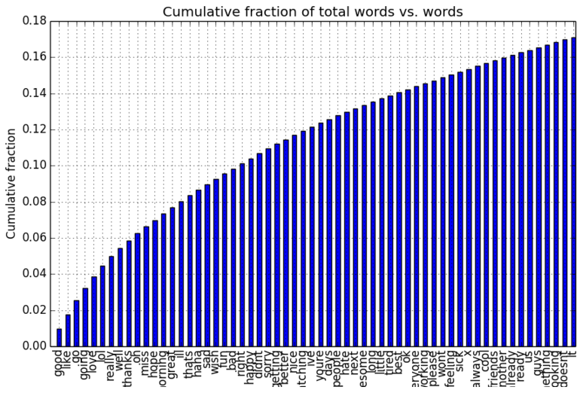
Cumulative frequency of words for tweets: stop words removed
Notes:
So here they are again. “Good” is about 1% of the words in itself. And then if you include a bunch more of the common words, it gets up to about 18% of the words that are tweeted here, just with these words. So that’s kind of a nice way to get a sense about the frequency of words in English.

Slide 10
Stemming Words

Slide 11
Stemming Words
Reduces words to their stems. Helps with information retrieval.
connection, connected, connective, connecting ➔ connect
train, trains, train’s, trains’ ➔ train
the child’s trains are connected ➔ the child train be connect
Note: this analysis is limited to English.
Notes:
Stemming words means
*reducing words to their stems, which is helpful in information retreival applications. When you’re searching for a word.
*here’s an example, where all of these words map to the same stem here. So when we’re searching for documents that contain “connect” we also get the ones that have connected, connective, and so on.
*Same thing with train
*So that if you stem the whole sentence you get something like this.
* obviously all of this is completely limited to English. It doesn’t generalize to other languages necessarily.
http://xapian.org/docs/stemming.html

Slide 12
Stemming Words
Porter’s algorithm (1980):
V is one or more vowels (A, E, I, O, U),
C is one or more consonants.
All words are of the following form:
[C]VCVCVC…[V]
[C](VC){m}[V] ⬅ m copes of VC
For each word, we check whether it obeys a condition, and shorten or lengthen it accordingly.
m=0 KN, EE, KNEE, Y, BY.
m=1 BUBBLE, OAKS, KNEES, IVY.
m=2 BUBBLES, PRIVATE.
Notes:
I’m going to teach you about an algorithm called
*“Porter’s stemming algorithm” and it comes from one central idea. So let me explain to you the idea before showing you the algorithm. The first thing is that you have to break each word up into groups of vowels,
*obviously aeiou and consonants
*which is everything that isn’t a vowel. V is a group of vowels that are adjacent. and C is a group of adjacent consonants. So if you have 2 vowels together, that’s a V group, and if you have 2 consonants together, that’s a C group.
Now the idea behind Porter’s algorithm is to say that all words are of the following form
like that. So this means an optional consonant, and then alternating groups of vowels and consonants, and then an optional vowel group at the end.
Another way to write that is like this. An optional consonant at the beginning of the word, then m copies of a vowel group followed by a consonant group and then at the end an optional vowel group.
Here are some examples. So these chunks of letters all have m=0 because there are no V groups followed by C groups. *ad lib*
now the way the algorithm works is that there are a bunch of rules that are written out manually. And we follow the rules. Each rule tells us to check whether the word obeys a condition and then the rule tells us how to shorten or lengthen the word.

Slide 13
Porter’s Algorithm, Step 1:
SSES ➔ SS (e.g., caresses ➔ caress)
IES ➔ I (e.g., ties ➔ ti, ponies ➔ poni)
S ➔ <remove> (e.g, potatoes ➔ potato)
IF m>0 Then EED ➔ EE (e. feed ➔ fee)
If stem contains vowel and has ED ➔ <remove> (e.g, turned ➔ turn)
If stem contains vowel and has ING ➔ <remove> (e.g, turning ➔ turn)
If either of the green rules are successful,
AT ➔ ATE (conflat ➔ conflate)
BL ➔ BLE (troubl(ed) ➔ trouble)
IZ ➔ IZE (siz ➔ size)
<vowel>Y ➔ I (e.g, happy ➔ happi , whereas sky ➔ sky not ski)
Notes:
Here are the rules for step 1. So we’ll replace SSES with SS, so *ad lib*
m>0 -> at least one VC clause
Ok so I’ve been through step 1 in detail but this is just the begninning. Porter’s algorithm actually has lots of rules like this.

Slide 14
Porter’s Algorithm: Step 2
(m>0) ATIONAL ➔ ATE relational -> relate
(m>0) TIONAL ➔ TION conditional -> condition
(m>0) ENCI ➔ ENCE valenci -> valence
(m>0) ANCI ➔ ANCE hesitanci -> hesitance
(m>0) IZER ➔ IZE digitizer -> digitize
(m>0) ABLI ➔ ABLE conformabli -> conformable
(m>0) ALLI ➔ AL radicalli -> radical
(m>0) ENTLI ➔ ENT differentli -> different
(m>0) ELI ➔ E vileli - > vile
(m>0) OUSLI ➔ OUS analogousli -> analogous
(m>0) IZATION ➔ IZE vietnamization -> vietnamize
(m>0) ATION ➔ ATE predication -> predicate
(m>0) ATOR ➔> ATE operator -> operate
(m>0) ALISM ➔ AL feudalism -> feudal
(m>0) IVENESS ➔ IVE decisiveness -> decisive
(m>0) FULNESS ➔ FUL hopefulness -> hopeful
(m>0) OUSNESS ➔ OUS callousness -> callous
(m>0) ALITI ➔ AL formaliti -> formal
(m>0) IVITI ➔ IVE sensitiviti -> sensitive
(m>0) BILITI ➔ BLE sensibiliti -> sensible
Notes:
Here is step 2 for instance, and Steps 3, 4, and 5 are similar sets of rules like this. So you get the idea of Porter’s algorithm now.

Slide 15
Porters Algorithm Notes
It’s not perfect, but often improves information retrieval performance.
Severing vs. several => sever
University vs. universe => univers
Iron vs. ironic => iron
Notes:
Porter’s algorithm is nice. It’s *click read*
It does mess up on occasion. For instance, *click Read*
But it is very useful in general and doesn’t mess up all that often.
And it helps you know that pony on one page should be considered similar to ponies on another page. Or when you count the number of times pony appears on a page, you can also count occurences of ponies together with it.

Slide 16
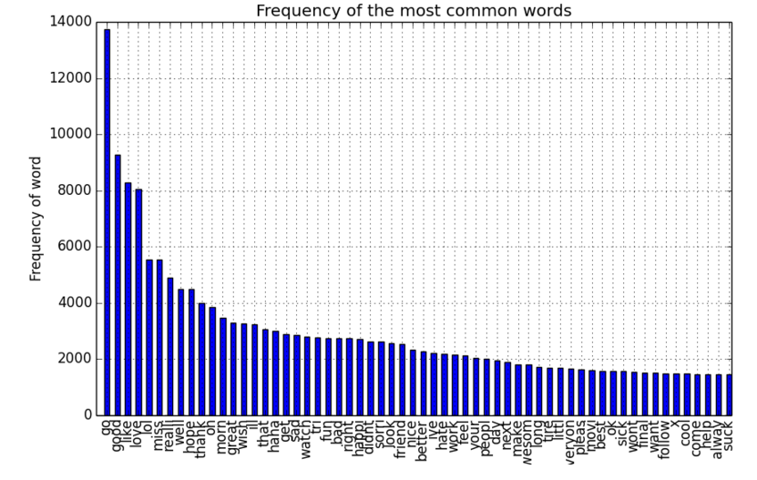
Frequency of stemmed words for tweets: stop words removed
Notes:
So you might be wondering what are the most popular nontrivial words. Have you ever wondered that? How would you get that? You might take the collection of words in a large corpus of text, say a set of tweets for instance, then remove all the stop words like “the” “and” “if” and “but” and so on, and then stem everything so that you get things like love and loves counted together. And then you might do a pareto chart to find the most popular words. Can you guess what they are? I can show you the answer to this one.

Slide 18
TF-IDF
Notes:
So now that you have the stemmed words, what can we do with them? Maybe we could figure out how important they are.

Slide 19
TF-IDF: Term Frequency Inverse Document Frequency
How can you tell how important a word is?
Term Frequency - the number of times you see a word.
Inverse Document Frequency
– log(1/(fraction of documents the word appears in)).
TF-IDF: Term Frequency * Inverse Document Frequency
Notes:
*TF-IDF helps you answer the question “How can you tell how important a word is?” Of course When I say word I really mean word stem since I stemmed them.
* TF-IDF is a key factor used in search engines. Let me tell you what this thing means.
*TF is term frequency, which is just the number of times you see a word
*IDF is inverse doc frequency which is related to the inverse of the fraction of documents the word appears in. And TF-IDF is term frequency* inverse document frequency.
So let me explain a little more about the intruition behind what this does.

Slide 20
TF-IDF: Term Frequency Inverse Document Frequency
How can you tell how important a word is?
Term Frequency - the number of times you see a word.
“The” is very frequent.
But it appears in all the documents
Inverse Document Frequency
1
Notes:
Let’s talk about term frequency. You’d think a word would be important if it’s frequent. But the word
*the is very freqent.
*It appears in all the documents, but it’s not very important. So term frequency is not the answer. I mean, definitely a word in a document that’s important should appear frequently, which makes sense. But we can’t use term frequency on it’s own to determine whether a word is important.
*That’s why we need idf. IDF says that we should also look at 1/the number of documents where the word appears. The word “the” appears in all the documents, so this number is going to be really small, and so “the” won’t get a high score on this one. To get a high IDF score, the word has to appear in only a few documents. And then we multiply by the number of documents and there’s a log around the outside just to balance out the scales a little bit.

Slide 21
TF-IDF: Term Frequency Inverse Document Frequency
TF-IDF: When is it high?
When the term appears many times in few documents
TF-IDF: When is it low:
When the term appears in almost all documents
When the term does not appear often
Notes:
click *read* so what does TF IDF like? IT liked is when you’ve got a term that is really important for *this* documents, but not appearing much in other documents.
read
what will get you a low TF IDF score?
when the term appears in almost all the documents. Then it’s not important. Or
if the term doesn’t appear very often, it’s hard to justify that it’s particularly important.
*TF-IDF is a key factor used in search engines. It tells you the sort of general importance of each word.

Slide 23
Subfields of Natural Language Processing
All of these often use machine learning.
Notes:
There are many more subfields I cant name

Slide 24
Named Entity Recognition

Slide 25
Named Entity Recognition
Labels words that are names of things
people
organizations
locations
genes proteins
:

Slide 26
Named Entity Recognition
Cynthia and Steve worked for Duke and Quantia Analytics in 2016 in Niagara.
Notes:
For example take this sentence

Slide 27
Named Entity Recognition
Cynthia and Steve worked for Duke and Quantia Analytics in 2016 in Niagara.
Person
Organization
Location
Notes:
Here the named entity recognizer labels words that are names of people, organizations, or locations.
If you have this information, you can search effectively for answers to complicated questions like *

Slide 28
Named Entity Recognition
Cynthia and Steve worked for Duke and Quantia Analytics in 2016 in Niagara.
Person
Organization
Location
What are all organizations mentioned in a set of legal documents?
What places were involved in articles about a military group?
Notes:
So these named entity recognizers can be particularly useful.

Slide 29
Part of Speech Tagging
Assigns each word in a sentence to a part of speech.
noun
adjective
verb
adverb
Notes:
pos tagging is another subfield of NLP, where the goal is to assign each word in a sentence to a part of speech. For instance you’d like to know whether each word in a sentence is a noun, adjective, or whatever.

Slide 30
Part of Speech Tagging
Boil water in a big vat.
verb
noun
noun
det
prep
adj
Why is this hard?
Notes:
Kind of like this.
* read, looks simple, right? You just label all times you see in with a preposition and it’s easy, right? Well, no. It’s even difficult for this simple sentence to do it.

Slide 31

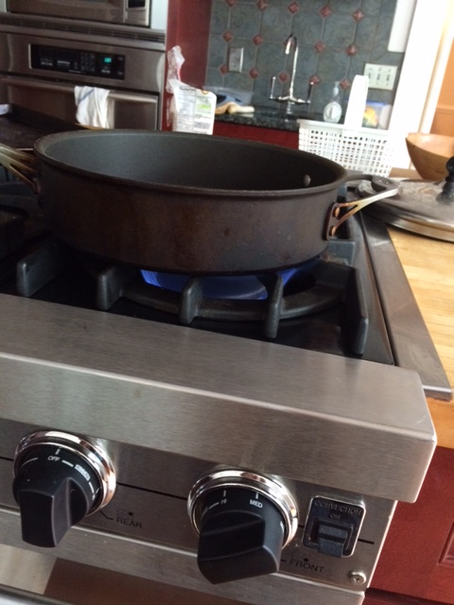
Part of Speech Tagging
Boil water in a big vat.
verb
noun?
Notes:
The word “boil” might be a verb, like boil water, or it might be a noun, like a boil on your knee or something.

Slide 32


Part of Speech Tagging
Boil water in a big vat.
noun
verb?
Notes:
Water also has 2 meanings in English, It could be water in a glass which is a noun, or it could be watering a plant which is a verb.

Slide 33
Part of Speech Tagging
When text becomes speech sometimes the noun version is pronounced differently than the verb version.
“I object to your taking this class.”
“What is that object you’ve got in your hand?”
Notes:
So why do you care if we get the nouns and verbs labeled? Let’s say you’re building a speech synthesizer that is supposed to sound natural. Now as it turns out, you *really* need to know whether you’ve got the noun version or the verb version of a word. Because
read
so you kind of need to know whether it’s the noun version or the verb version that’s in the language there. Otherwise your speech program will sounds a bit weird. Let me try it with the right pronunciation sounding a litlte artificial, like I’m the speech module of the program. **Now the wrong prononciation. ** it just doesn’t sound right. If I knew that object was a verb the speech would sound much more natural.

Slide 34
Part of Speech Tagging
Boil water in a big vat.
verb
noun
noun
det
prep
adj
Notes:
Ok so let me give you a little insight about how the speech gets tagged. One popular way to do it is to use a probabilistic machine learning model to do the tagging.

Slide 35
Part of Speech Tagging
Sentence W=w₁,w₂,w₃,…,w_{n}
Boil water in a big vat.
Assign a sequence of tags T=t₁,t₂,…,t_{n}
Choose T to maximize P(T|W)
Notes:
You view the sentence as a string of words, like “Boil water in a big vat” Then your goal is to assign a sequence of tags, one for each word. You will choose those tags to maximize the probability that those tags belong to those words. From there it gets complicated. These models apply Bayes rule. Then they create models for sequences of tags and for the probabilities that a particular word arises from a tag, I will spare you the details since it’s an introductory lesson but it’s not too complicated. And this is the starting point, to create a probabilitstic model.

Slide 36
Parsing

Slide 37
Parsing
Steve is living in Seattle.
S
Parts of Speech are included
So are phrases (NP = noun phrase, VP = verb phrase)
Helps with machine translation
Helps with sentiment analysis
VP
NP
|
N
|
Steve
V
|
is
VP
V
|
living
PP
P
|
in
NP
|
N
|
Seattle
Notes:
In parsing the goal is to produce what’s called a parse tree, which provides a structure to the sentence.
*The parse tree includes the information about parts of speech
it includes phrases (for instance here a noun phrase includes nouns, so for instance the word Steve here is a noun phrase. And it also includes verb phrases like “living in Seattle” here.
Having the parse tree is super helpful for machine translation because when you go to translate it into the other language, you know how the parse tree for the sentence ought to look in the other language, so you can put the words in the right order in the new language.
Also having the parse tree helps with sentiment analysis because you can understand where words are in context, you can tell whether the word excellent is in the same phrase as the product or whether its in an unrelated phrase.

Slide 38
Sentiment Analysis

Slide 39
Sentiment Analysis
Why don’t customers like our product?
Tweets use words like:
slow, hideous, lousy, awful, wasteful
Our competitors’ tweets use words like:
awesome, best, cool, fun, loved it
Notes:
In sentiment analysis we’re trying to figure out whether the writer has a positive perspective or a negative perspective. Companies that sell products online really want to do sentiment analysis, because they want to know things like why cusomers don’t like our product?
well, if the tweets for the product use phrases like *Read* and if
our customers tweets use words like *read* then that would explain it.
Ok so why is this hard? Seems obvious, right? We’ll it’s not.

Slide 40
Sentiment Analysis
5 stars: “This product is a crazy idea. I can’t believe I’m actually writing a review of it, I originally thought the idea was terrible, but it’s actually very nice. It allows you to blow lots of bubbles really slowly, so the whole yard is filled with bubbles of all sizes. I ended up totally going for it!
Notes:
Try to use keywords to classify this one. This is a 5 star review.*Read* It has the words crazy, “can’t believe” terrible” it also has “nice” which is confusing. It’s not easy to classify this one.

Slide 41
Sentiment Analysis
1 star: “I tried this and didn’t have much luck getting it to work. Yesterday I bought a different bubble machine, and it was great, the bubbles came out really fast, and the setup was easy and fun. I loved that one, so I don’t recommend purchasing this.”
Notes:
And look at this reivew, which was a 1 star review. *Read* it uses a lot of positive words, and yet it doesn’t recommend the product. So just using a bag of words wont’ do it, you actually need to know more about the structure of the language in the review. That said, if you did just use the words in the reviews to do sentiment analysis, you can get a pretty accurate classifier, so it definitely would work to some extent.

Slide 42
Sentiment Analysis
Can use supervised learning (if we have labeled data)
Features might be:
Average sentiment of the words in the full review.
“I tried this a couple of times and really liked it. The setup was difficult and annoying, but when I finally got it assembled the bubbles were totally awesome. I would definitely recommend this product.
Average sentiment of single words that reference the product.
“The bubble blower is so awesome…”
“… nevermind that. Let’s discuss the bubble blower, which has worked out great so far…”
Notes:
*Sentiment analysis is often done by supervised learning (assuming we have a labeled corpus of text to learn from). If you want to classify documents into “positive and negative” you might construct a set of feature like
*
average sentiment of the words in the full review. *Read* So here words like difficult and annoying would be offset by awesome and definitely recommend
another feature might be the average sentiment of single words that directly reference the product” *Read* so here awesome is referring to the bubble blower directly.
*read* so here we would associate great with the bubble blower.
if you have a parse tree you could handle stuff like this.

Slide 43
Notes:
I hope you enjoyed this overview of important topics in NLP.

Slide 45
Stemming Words
Step 3
(m>0) ICATE -> IC triplicate -> triplic
(m>0) ATIVE -> formative -> form
(m>0) ALIZE -> AL formalize -> formal
(m>0) ICITI -> IC electriciti -> electric
(m>0) ICAL -> IC electrical -> electric
(m>0) FUL -> hopeful -> hope
(m>0) NESS -> goodness -> good
Step 4
(m>1) AL -> revival -> reviv
(m>1) ANCE -> allowance -> allow
(m>1) ENCE -> inference -> infer
(m>1) ER -> airliner -> airlin
(m>1) IC -> gyroscopic -> gyroscop
(m>1) ABLE -> adjustable -> adjust
(m>1) IBLE -> defensible -> defens
(m>1) ANT -> irritant -> irrit
(m>1) EMENT -> replacement -> replac
(m>1) MENT -> adjustment -> adjust
(m>1) ENT -> dependent -> depend
(m>1 and (*S or *T)) ION -> adoption -> adopt
(m>1) OU -> homologou -> homolog
(m>1) ISM -> communism -> commun
(m>1) ATE -> activate -> activ
(m>1) ITI -> angulariti -> angular
(m>1) OUS -> homologous -> homolog
(m>1) IVE -> effective -> effect
(m>1) IZE -> bowdlerize -> bowdler
Notes:
still used

Slide 46
Stemming Words
Step 5a
(m>1) E -> probate -> probat
rate -> rate
(m=1 and not *o) E -> cease -> ceas
Step 5b
(m > 1 and *d and *L) -> single letter
controll -> control
roll -> roll
Notes:
still used

